Slide 1
Wireframe On Start-ups and Estimate of the IT services.
Submitted by- Arpita Basu
Batch 51

Slide 2
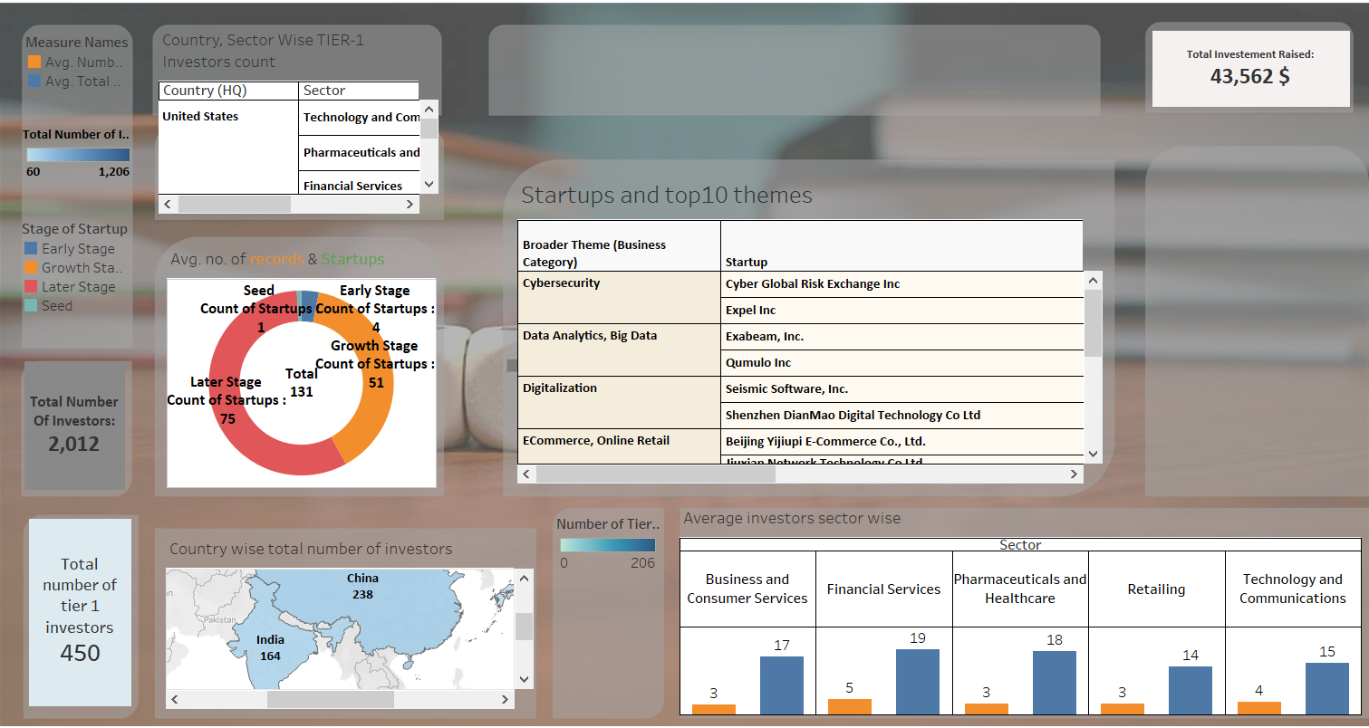

Slide 3
KPIs taken:
KPI 1- Total number of investors for the start-up
KPI2- Total number of Tier-1 investors
KPI3- Total investment raised
Colour palette used for the dashboard:
Shades of Blue, Orange, neutral Red to keep its soothing, yet appealing

Slide 4
Charts shown:
Top 10 business themes and start-ups based on each theme: Horizontal bars
Average Count of start-ups on the basis of stages of the start-ups: Donut
World map made to differentiate total number of investors of each countries
Country wise tier-1 investors count : Text tables
Sector wise average number of investors: side bars

Slide 5
Estimate of the wireframe:
IT SERVICES | Hours to decide on each service | Total Cost in(Rs)
Gathering of data & Cleaning | 3 hours | 3000
Data analysis | 2 hours | 2000
Creating KPIs | 15minutes | 500
Creating sheets | 4 hours | 2500
Creating wireframe structure | 1 hour | 900
Creating dashboard | 2 hours | 600
Creating Stories (if) | 2 hours | 1000
Inferences | 2 hours | 3000
Total | 16 hours 15m | 13500

